Slide 1

Having Fun with Java and ECLIPSE
Composed by : Cornelius Koo
HAck n DESign
IT Community
Salatiga - 2004

Slide 2
Why Java is Fun ?
Write once Runs Anywhere
The best language that support OOP
Distributed Computing in nature
Open Source
Free

Slide 3

Installing J2SDK (1.4)

Slide 4
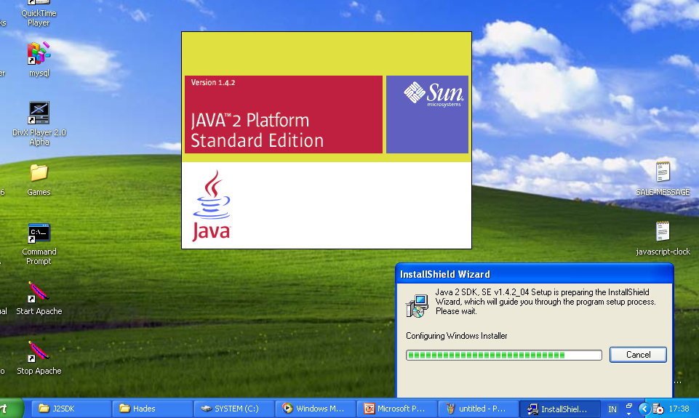

Slide 5
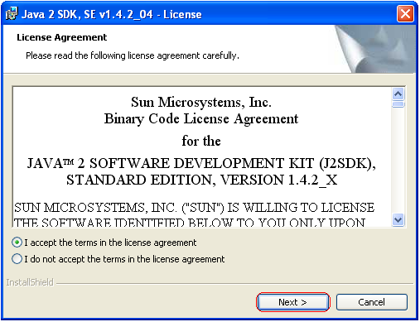

Slide 6
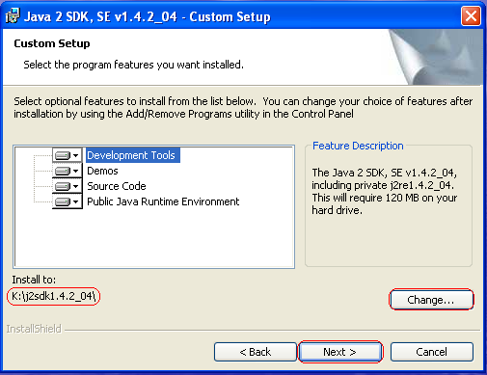

Slide 7
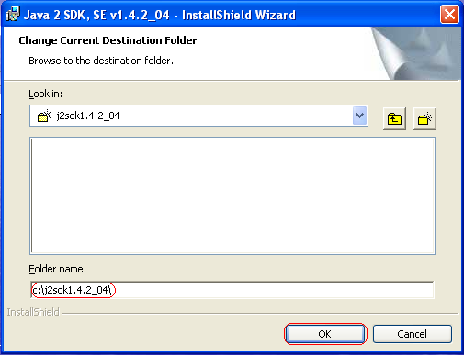

Slide 8
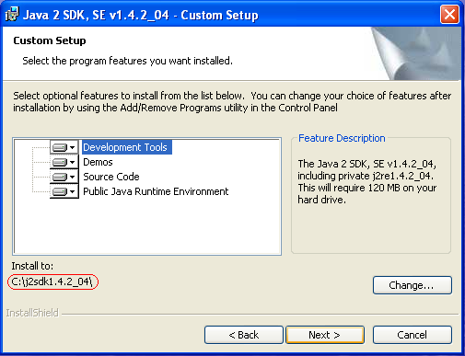

Slide 9
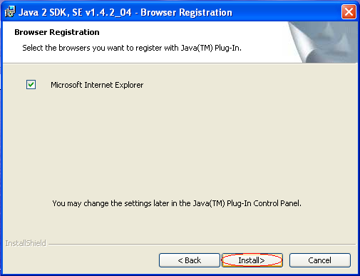

Slide 10
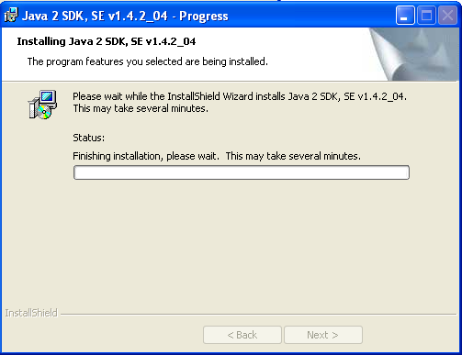

Slide 11
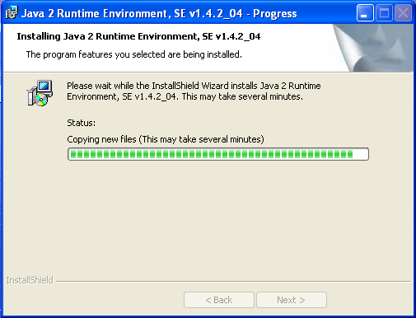

Slide 12
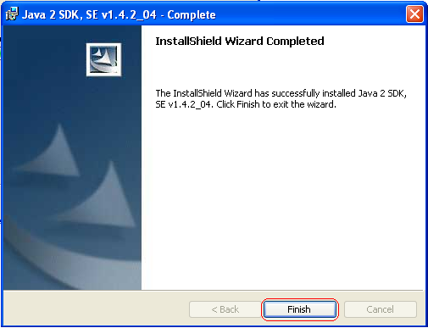

Slide 13
Setting Environment Properties
JAVA_HOME = C:\j2sdk1.4.2_04
PATH = %PATH%;C:\j2sdk1.4.2_04\bin
CLASSPATH = C:\javawork

Slide 14
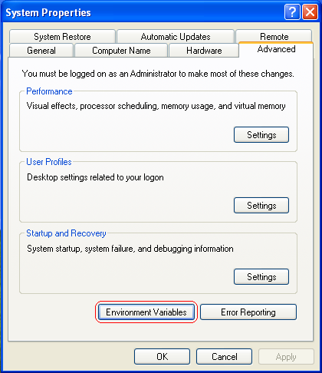

Slide 15
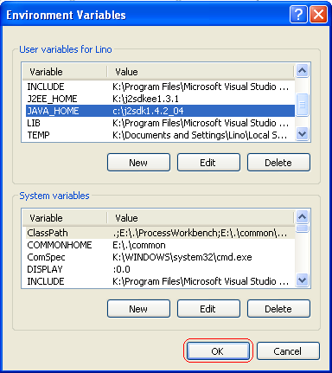

Slide 16
Installing API Document
Extract the J2SE API Doc to any drive
Create a shortcut to desktop, point it to API’s index.html

Slide 17

Installing Eclipse
Extract the Eclipse SDK to your drive
Create shortcut to desktop, point it to the eclipse.exe file

Slide 18
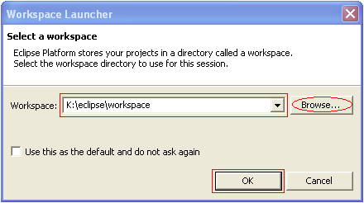

Slide 19

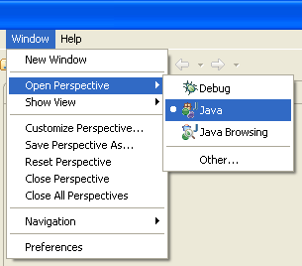
Perspective

Slide 20
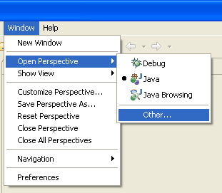
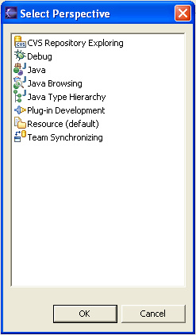

Slide 21


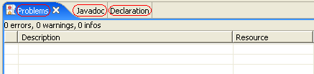
View

Slide 22
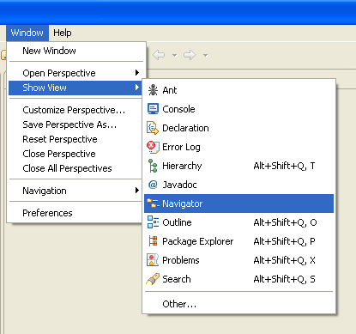
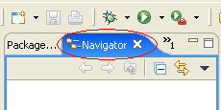

Slide 23
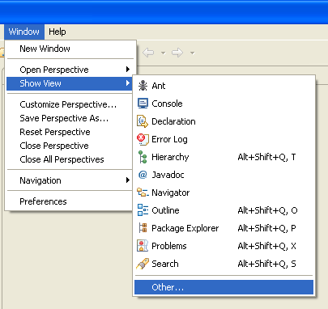
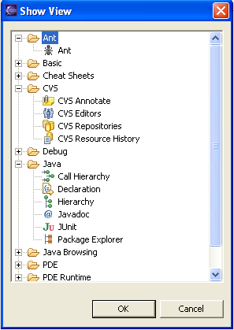

Slide 24
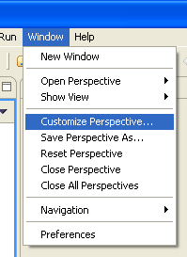
Customize Perspective

Slide 25
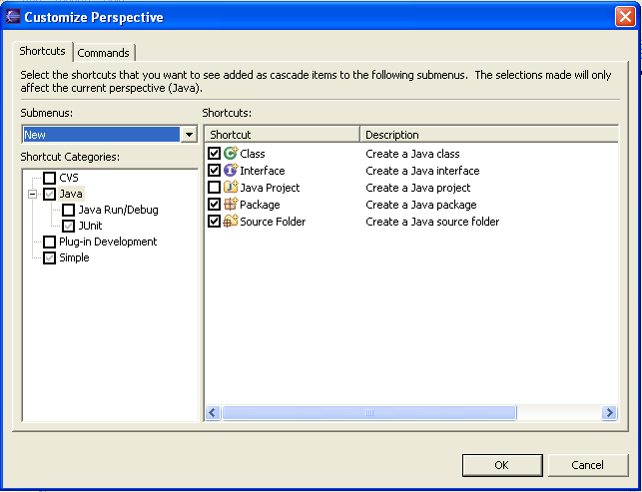

Slide 26
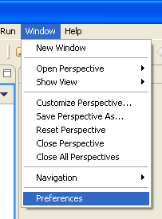
Preferences

Slide 27
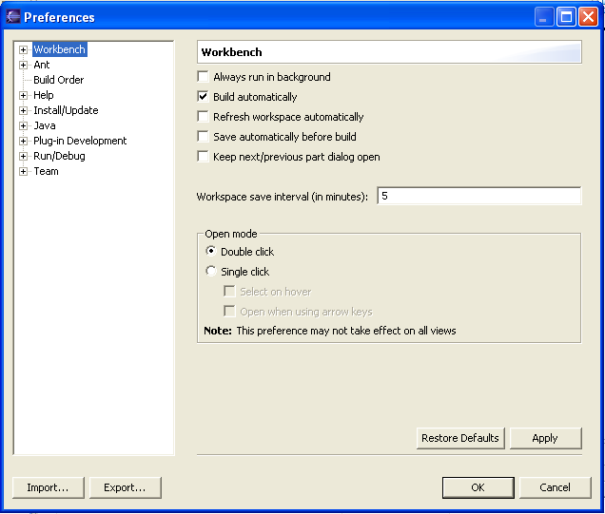

Slide 28
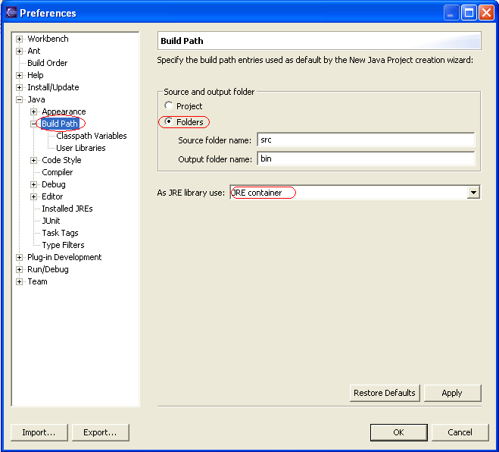
Setting Preferences

Slide 29
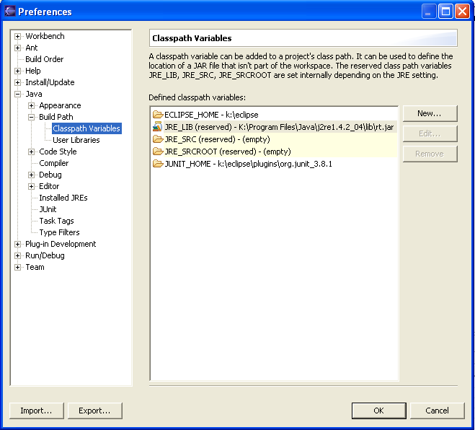

Slide 30
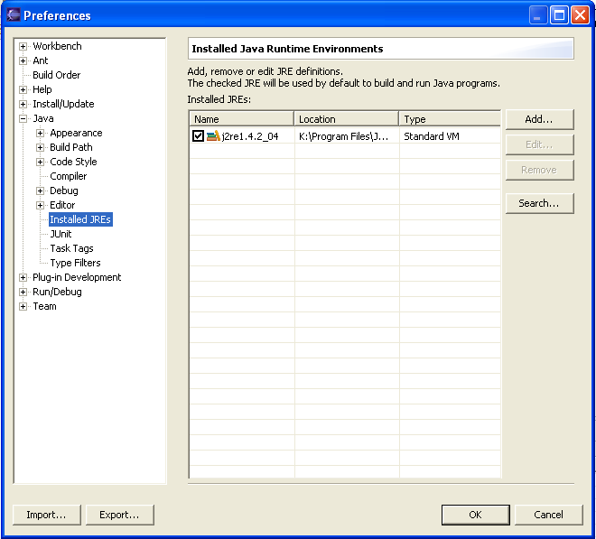

Slide 31
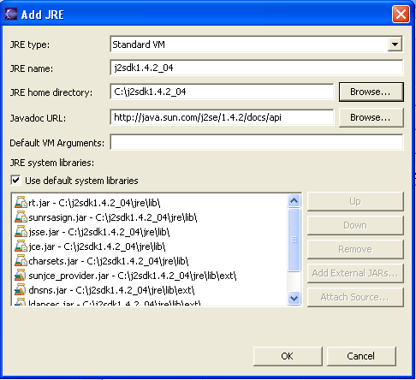
Adding JRE

Slide 32
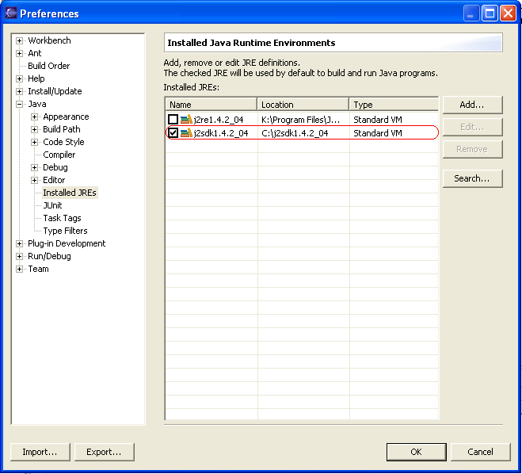

Slide 33
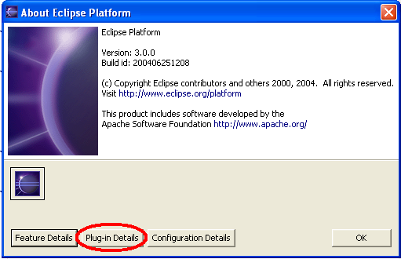
Looking Up Plugins

Slide 34
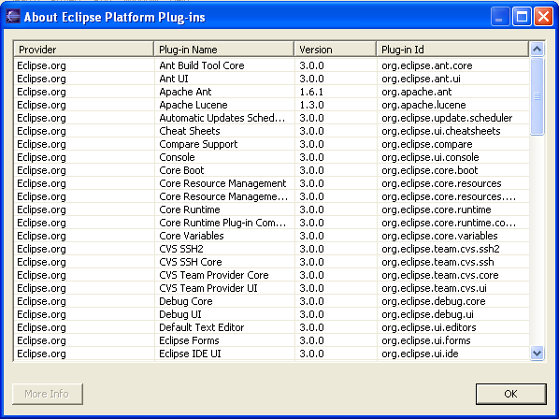

Slide 35
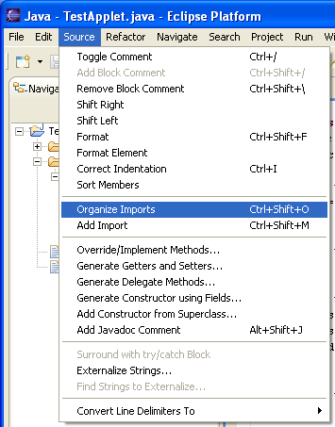
Organizing Imports

Slide 36
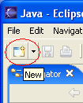
Create new Project
Create project before you create file components

Slide 37
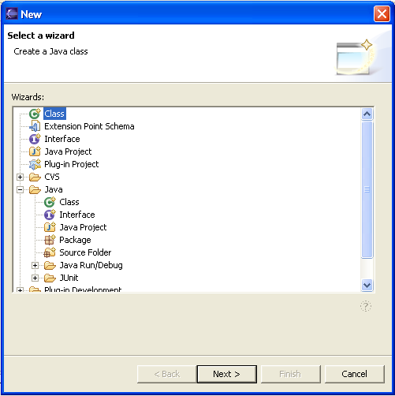
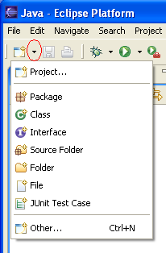

Slide 38
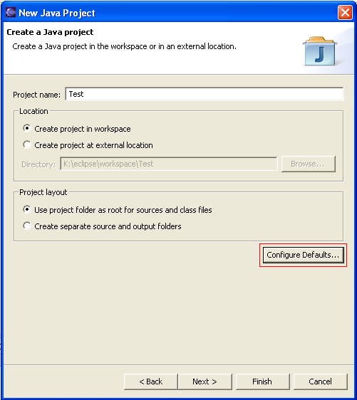

Slide 39
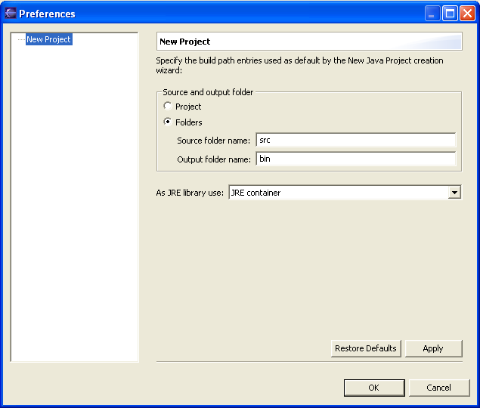

Slide 40
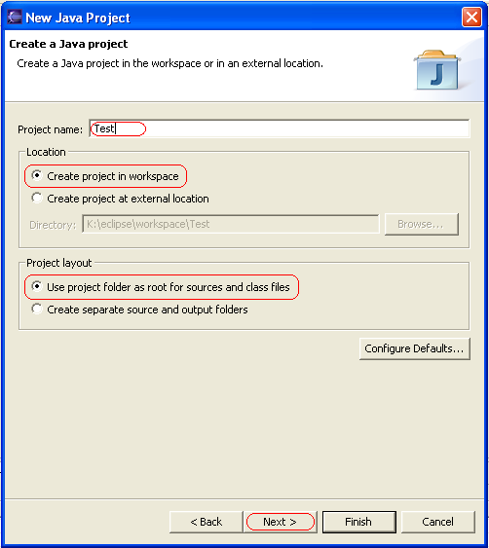

Slide 41
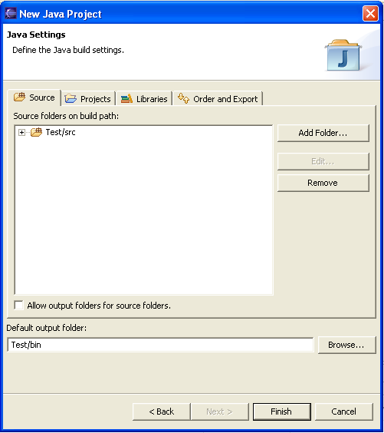

Slide 42
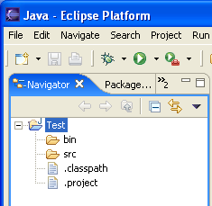

Slide 43
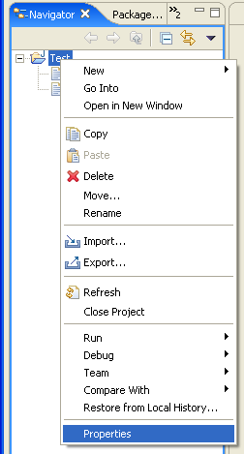
Project Properties

Slide 44
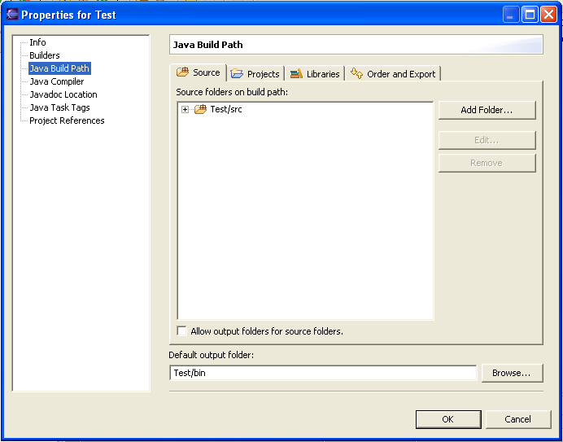

Slide 45
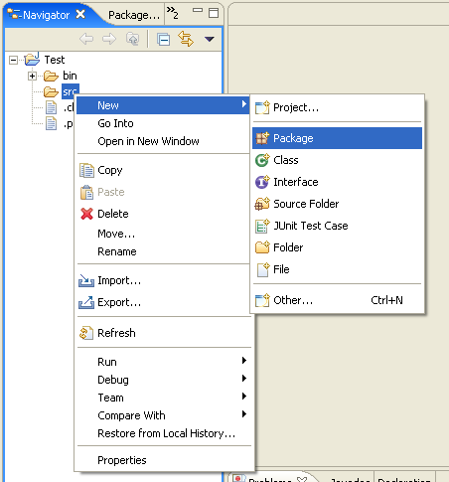
Create Your 1st Java Program

Slide 46
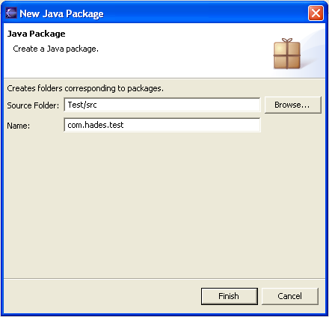
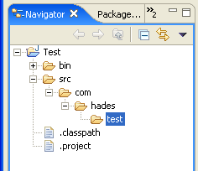
Creating Package

Slide 47
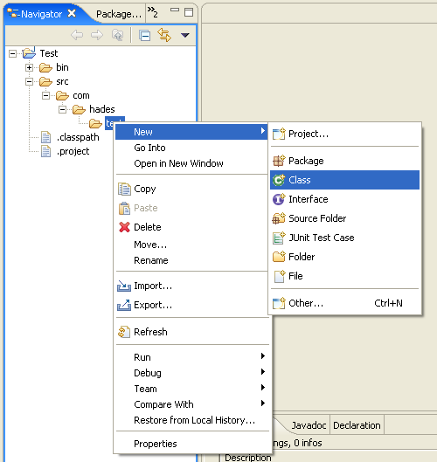
Creating Class

Slide 48
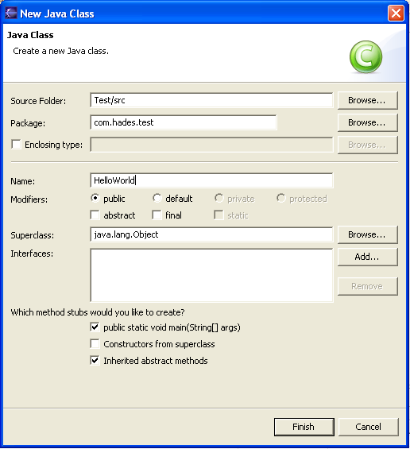

Slide 49
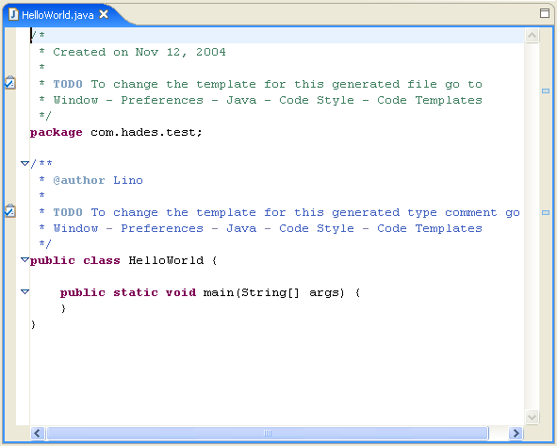
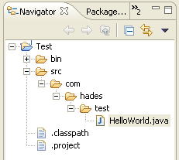

Slide 50
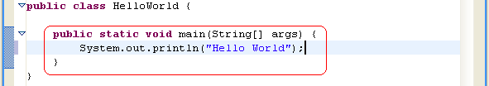

Slide 51


Running Your 1st Java Program

Slide 52


Slide 53


Slide 54

If Any Error Occur

Slide 55


Slide 56



Slide 57


Slide 58


Slide 59


Slide 60



Slide 61



Slide 62


Slide 63


Slide 64


Slide 65


Outline

Slide 66

Applet in Eclipse

Slide 67


Slide 68


Slide 69

JavaDoc Help

Slide 70
Other Helper
Try click ctrl-space inside your program

Slide 71



Slide 72

Running Applet

Slide 73


Slide 74



Slide 75
Swing in Eclipse
Install Jigloo plugin
Exit from eclipse
Extract the jigloo plugin into a directory, and copy its content into eclipse directory
Run Eclipse again

Slide 76


Slide 77


Slide 78


Slide 79


Slide 80


Slide 81


Slide 82



Slide 83



Slide 84


Slide 85


Slide 86


Slide 87

Setting Frame Layout

Slide 88


Slide 89


Slide 90


Slide 91


Slide 92


Slide 93


Slide 94



Slide 95


Slide 96


Slide 97
Summary
Java is Fun and Easy

